Slide 1


UNIVERSIDAD AUTÓNOMA DEL ESTADO DE HIDALGO
ESCUELA SUPERIOR DE ZIMAPÁN
Licenciatura en Derecho
Inglés V.
L.E.L.I. Paulina Trujillo Castillo
Julio – Diciembre 2016

Slide 2
Resumen (Abstract)
En esta presentación se explica el uso de los cuantificadores en inglés.
(In this presentation the use of quantifiers is explained.)

Slide 3
Palabras clave (Keywords):
Much, many, some, any, no, none, a lot of, lots of, few, a few, a little.
Mucho (s), algunos (as)/ algo, no, ningun (a), mucho (s)/ demasiado, poco.

Slide 4
Objetivo general:
El alumno podrá expresar eventos, sueños, expectativas y ambiciones; y de manera breve dar su opinión acerca de planes futuros, preferencias; así como enunciados ciertos o inciertos, hará énfasis del objeto del que se habla y no del sujeto que ejecuta la acción

Slide 5
Nombre de la unidad:
UNIDAD 3: Things we take on holiday
Objetivo de la unidad:
El alumno será capaz de hablar de cantidades utilizando diferentes expresiones. De la misma manera, será capaz de expresar una queja y hacer peticiones.

Slide 6
Tema:
3.1 Hablar de cantidades

Slide 7
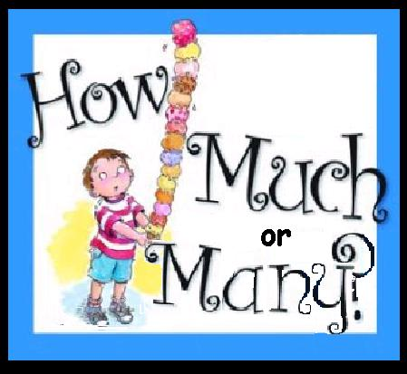
Desarrollo del Tema:
Quantifiers indicate (as its name says) quantity.
They are answers to the questions How much…? And How many…?
They can be used with countable and uncountable nouns, or sometimes both nouns.

Slide 8

Quantifier | Countable | Uncountable
Many | X
Much |  | X
Some | X | X
Any | X | X
No/ None | X | X
A lot of/ Lots of | X | X
Little/ A little |  | X
Few/ A few | X

Slide 9
We use quantifiers to express the idea of quantity or number, but let’s see how to use them especifically.

Slide 10

MANY
We use many to express the idea of a big quantity.
It is used in negative sentences and questions (when they are requests or offers) with uncountable nouns and with plural countable nouns.
Note: It is possible to use many in affirmative sentences, but it is more common to use a lot.

Slide 11

MUCH
Much expresses also the idea of a big quantity and it is used in negative sentences and questions.
Much is only used with uncountable nouns.
It is possible to use much in affirmative sentences, but this would be when our phrase is more formal and it is not very common.

Slide 12

SOME
It is used with uncountable nouns or plural countable nouns, in affirmative and interrogative sentences (just if we want to confirm something).
It is used for an indefinite quantity but limited.

Slide 13
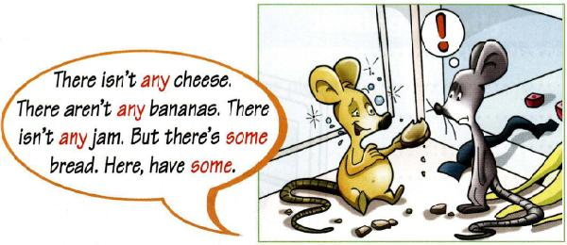
ANY
We use any in the same way as some, but in negative and interrogative sentences.

Slide 14


No/ none
We use no, as a negative meaning.
Unlike no, we can use none by itself, so it is common to use it at the end of phrases and as an answer for questions which make reference to quantities.

Slide 15
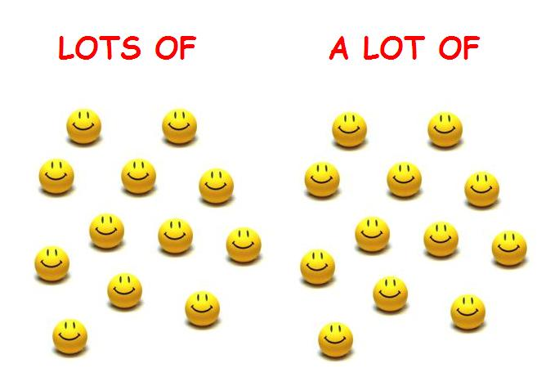
A LOT OF/ LOTS OF
They are used when we want to express a really big quantity. It can be used with countable and uncountable nouns.
We do not use them in questions.
Generally, lots of is more informal.

Slide 16


LITTLE/ A LITTLE
We use them to talk about a small quantity and we use them only with uncountable nouns.
The difference between them shows an opinion about quantity.
We use a little for a positive opinion and little expresses a negative opinion.

Slide 17

Few/ a few
They express a small number.
A few can be enough, and it is used only with countable nouns.
As in the previous slide, few expresses a negative opinion and a few describes it in a positive way.

Slide 18
Referencias bibliográficas:
Paul Davies, M. G. (2014). Make it Real! Professional. Mexico: Universidad Autónoma del Estado Hidalgo.

